Slide 1
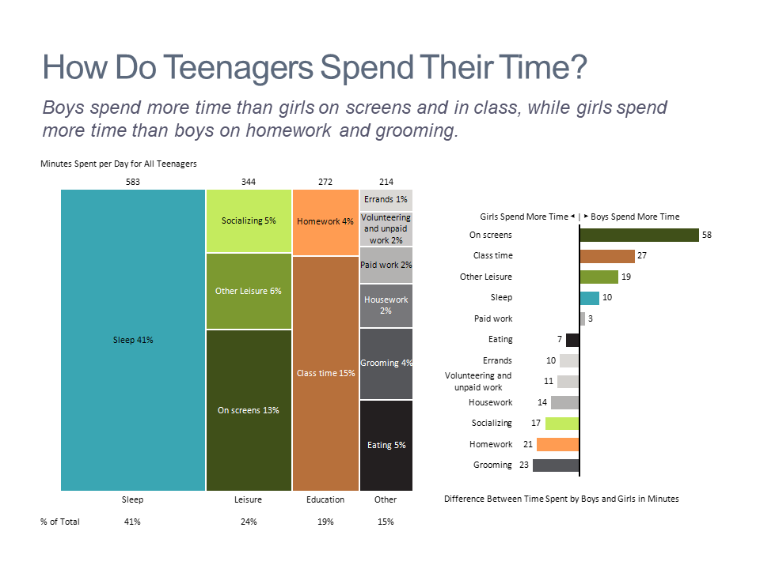
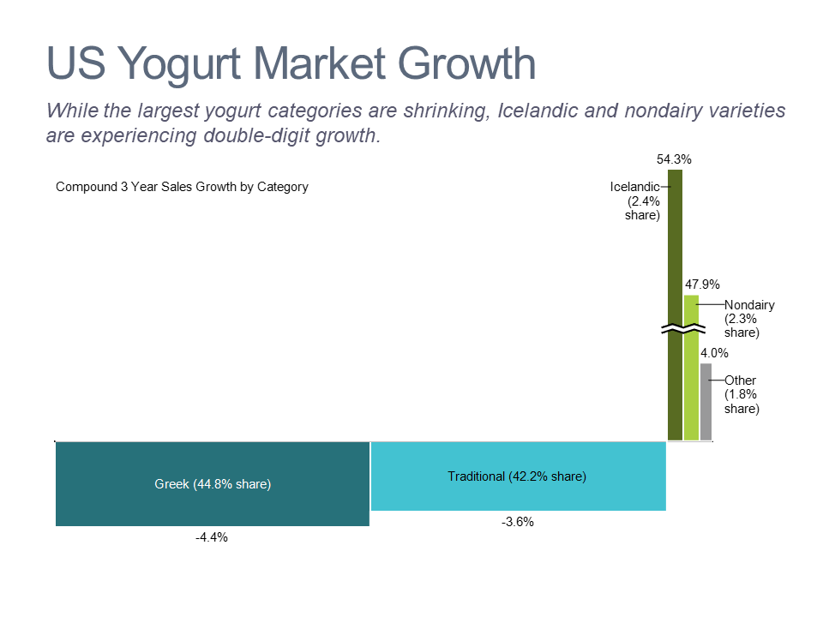
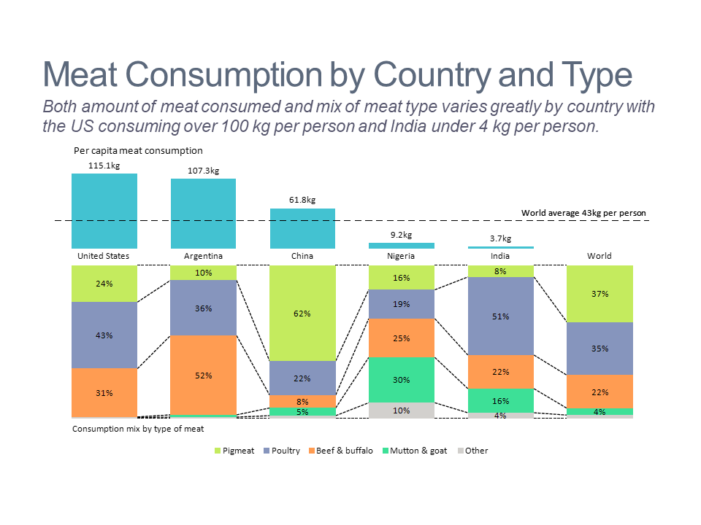
Top 5 Charts of the Week 2019

Slide 2
How Do Teenagers Spend Their Time?
Boys spend more time than girls on screens and in class, while girls spend more time than boys on homework and grooming.
Source: Pew Research
Learn how to make this chart

Slide 3
US Yogurt Market Growth
While the largest yogurt categories are shrinking, Icelandic and nondairy varieties are experiencing double-digit growth.
Source: Nielsen as reported in Wall Street Journal
Learn how to make this chart

Slide 4
Wine Customer Segmentation
The 84M wine consumers in the US fall into six different buying segments.
Source: Wine Intelligence US Portraits 2018
Learn how to make this chart

Slide 5
Meat Consumption by Country and Type
Both amount of meat consumed and mix of meat type varies greatly by country with the US consuming over 100 kg per person and India under 4 kg per person.
Source: Food and Agriculture Organization of the United Nations (FAO) as reported in Our World of Data
Learn how to make this chart

Slide 6
World’s Largest Unicorns
Twelve of the 20 unicorns with over $10B value are in the US, 5 in China and 3 in the rest of the world.
Source: CB Insights
Learn how to make this chart

