Slide 1
Using mekko graphics with excel
David Goldstein
President, Mekko Graphics

Slide 2
Three Productivity Examples
PowerPoint
Dashboard
Using PivotTables
Charts in Reporting Package
Apple Example
Connect an existing dashboard to Excel to simplify update process
Create a new dashboard chart in PowerPoint from data in Excel
Marimekko Example
Use a PivotTable to make it easier to create a marimekko chart in Excel or PowerPoint
Microsoft Example
Add Mekko Graphics chart to Excel spreadsheet used for financial analysis and reporting

Slide 3
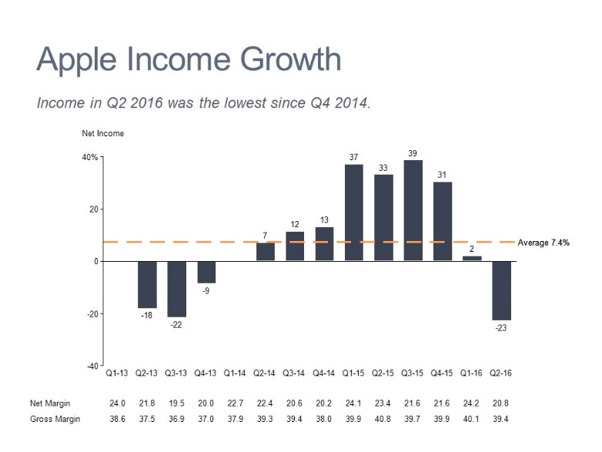
Apple Dashboard

Slide 4
Apple Revenue Trend
Revenue growth was negative for the first time in Q2 2016.

Slide 5
Apple Income Trend

Slide 6
Pivot Table Example
A pivot table makes it easier to create complex marimekkos.

Slide 7
50 Wealthiest

Slide 8
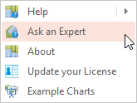
Resources
Learn
Ask
Connect
MekkoGraphics.com
Mekko Graphics Toolbar
Training videos
Chart Gallery
Presentations
Chart Selection Toolkit
Strategy Consultant’s Toolkit
Chart of the Week
Build Your CQ Blog
FAQs
Palettes

