Slide 1
How to Make a Market Map
David Goldstein
President
February 24, 2015

Slide 2
Agenda
What is a market map?
Why would you use one?
Where would you find the data needed to build one?
How do you build a market map with Mekko Graphics?
How do you tweak it to become a ‘million dollar chart?’

Slide 3
What Is a Market Map?
Two-dimensional chart that shows breaks down sales into two categories
One category is typically competitor
The other is often region or market segment
Examples:
Broadband usage by provider and country maps the European broadband market
US auto sales in units by segment and competitor
IT spend by segment and sub-segment

Slide 4
Why Build a Market Map?
Show the relative size of market segments
E.g., what are the largest segments of the IT market?
Identify opportunities for consolidation
Segments with many smaller competitors
Find the ‘white space’
Segments that your company is not in or is relatively weak
Determine segments to exit
I.e., segment with a dominant competitor

Slide 5
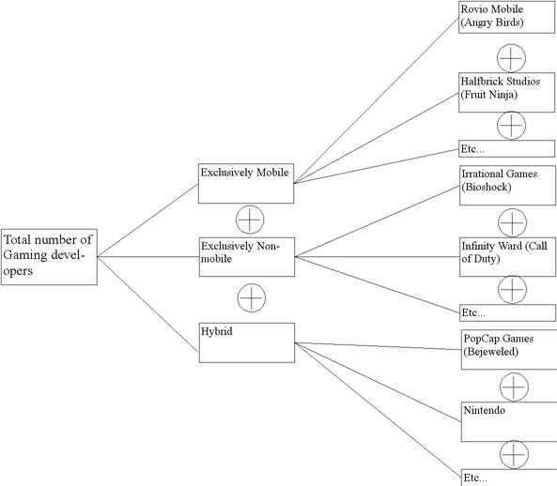
Before You Get Started
Categories and sub-categories should be “MECE”—mutually exclusive and completely exhaustive
Need to identify all relevant categories and sub-categories with no overlaps
Can group smaller segments into “other”
Market maps are for a single time period
They are not a good chart for tracking trends over time

Slide 6
Market Map Data Sources
Internet for ‘popular’ and regulated industries
Auto (but not wiper blades)
Tech—smartphones, broadband, PCs
Airlines
Industry analysts
Paid reports
Company financials
Often hard to get segment data
Internal/partner resources
Your sales team or partners
Estimates are OK
GOOD CAR BAD CAR
Passionate Tracking Of Auto Sales Data

Slide 7
US Auto Industry Market Map
Cars and SUVs are largest segments and both are very fragmented with the top 5 models having under 30% share. The pick-up segment is much more consolidated.
Source: Good Car Bad Car

Slide 8
US Auto Industry Data
Data from web:
Data in Mekko Graphics datasheet:
Rank | Car | 2014 | 2013 | % | December | December | % Change
 |  |  |  | Change | 2014 | 2013
#1 | Toyota Camry | 428,606 | 408,484 | 4.90% | 31,618 | 29,964 | 5.50%
#2 | Honda Accord | 388,374 | 366,678 | 5.90% | 31,589 | 32,321 | -2.30%
#3 | Toyota Corolla/Matrix | 339,498 | 302,180 | 12.40% | 30,125 | 22,562 | 33.50%
#4 | Nissan Altima | 335,644 | 320,723 | 4.70% | 32,331 | 24,816 | 30.30%
#5 | Honda Civic | 325,981 | 336,180 | -3.00% | 25,337 | 29,000 | -12.60%
#6 | Ford Fusion | 306,860 | 295,280 | 3.90% | 23,166 | 24,408 | -5.10%
#7 | Chevrolet Cruze | 273,060 | 248,224 | 10.00% | 17,800 | 18,162 | -2.00%
#8 | Hyundai Elantra | 222,023 | 247,912 | -10.40% | 18,860 | 21,692 | -13.10%
#9 | Ford Focus | 219,634 | 234,570 | -6.40% | 14,883 | 15,569 | -4.40%
#10 | Hyundai Sonata | 216,936 | 203,648 | 6.50% | 17,924 | 14,479 | 23.80%
#11 | Chevrolet Malibu | 188,519 | 200,594 | -6.00% | 16,817 | 15,493 | 8.50%
#12 | Nissan Sentra | 183,268 | 129,143 | 41.90% | 15,393 | 10,799 | 42.50%
#13 | Volkswagen Jetta | 160,873 | 163,793 | -1.80% | 15,578 | 15,393 | 1.20%
 | …
--- | Total | 7,935,161 | 7,801,870 | 1.70% | 679,303 | 632,957 | 7.30%

Slide 9
Building US Auto Industry Market Map

Slide 10
Tips to Make Your Market Map a Million Dollar Chart
Keep the number of series in each bar under 10, to make the chart more readable
Use ‘Other’ series to group smaller data
Sort your bars biggest on left and series biggest on bottom
Use color and shading to highlight or group
Highlight key company
Group similar companies or subsidiaries based on color or shades
Add a data row for segment growth, margins or other key data

Slide 11
Questions and Next Steps
Questions?
Use chat feature of GoToMeeting
Also, can you suggest other topics for ‘how to’ webinars?
Resources
http://www.mekkographics.com/resources/charts-by-type/marimekko/
http://www.mekkographics.com/resources/blog/
Email us at: support@mekkographics.com or david@mekkographics.com

