Slide 1
Building a Strategy presentation
David Goldstein
President, Mekko Graphics
david@mekkographics.com

Slide 2
3 Steps to Building Your Presentation
Conceiving (before PPT)
Visualizing (with PPT)
Delivering
What’s my role? Who is the audience? What’s the “Big Idea?” | How do I structure my presentation? Which charts and diagrams should I use? How can I maximize visual impact? | What pre-presentation preparation should I make? How should I deliver the talk? handle Q&A?
Focus of this presentation

Slide 3
3 Steps to Building Your Presentation
Conceiving (before PPT)
Visualizing (with PPT)
Delivering
What’s my role? Who is the audience? What’s the “Big Idea?” | How do I structure my presentation? Which charts and diagrams should I use? How can I maximize visual impact? | What pre-presentation preparation should I make? How should I deliver the talk? handle Q&A?

Slide 4
Before You Open PowerPoint
Your Role
Teacher/mentor
Audience
Who are they?
Big Idea
Point of view
What’s at stake?
Story
Empower your audience to take action
7 Questions to ask
Beginning, middle and end
Make it memorable

Slide 5
7 Questions to Know Your Audience
What are they like?
Why are they here?
What keeps them up at night?
How can you solve their problem?
What do you want them to do?
How might they resist?
How can you best reach them?

Slide 6
Before You Open PowerPoint
Your Role
Teacher/mentor
Audience
Who are they?
Big Idea
Point of view
What’s at stake?
Story
Empower your audience to take action
7 Questions to ask
Beginning, middle and end
Make it memorable

Slide 7
3 Steps to Building Your Presentation
Conceiving (before PPT)
Visualizing (with PPT)
Delivering
What’s my role? Who is the audience? What’s the “Big Idea?” | How do I structure my presentation? Which charts and diagrams should I use? How can I maximize visual impact? | What pre-presentation preparation should I make? How should I deliver the talk? handle Q&A?

Slide 8
Keys to Great Slides
3 second rule
Action title
Lose the jargon
Highlight what’s important
Replace word walls with tables and diagrams
Choose the chart that best fits your message

Slide 9
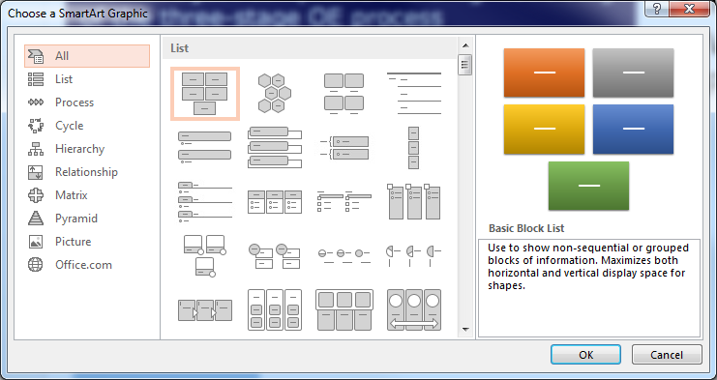
Find the Best Diagram
1.
2. Flevy PowerPoint Toolkit
http://flevy.com/powerpoint-toolkit.php

Slide 10
Diagram Options--Flow
Timelines
Value chains
Process flows

Slide 11
Diagram Options--Hierarchies
Organization structure
Pyramids

Slide 12
Diagram Options--Tables
Comparisons
Summarize/ replace word walls

Slide 13
Which Chart to Use
Objective | Example | Chart Type
Categorize one measure and dimension | Revenue by business unit or by product line Costs by business unit or by plant | 100% stacked bar (1 bar)
Track trends | Revenue by year for by business unit Costs by year by business unit | Stacked bar or 100% stacked bar
Categorize one measure along 2/3 dimensions | Revenue by product line and region Price versus product performance and revenue | Marimekko Bubble
Categorize one dimension along two measures | Market size versus market growth by product | Bar Mekko
Track changes | Factors that affect change in profit | Cascade

Slide 14
Categorize Along One Dimension Using 100% Stacked Bar
Extra credit: Add a 2nd bar to ‘explode’ a key segment.

Slide 15
Track Trends with a Stacked Bar
Extra credit: Add a growth arrow or a CAGR column to quantify growth trends

Slide 16
Categorize along 2 Dimensions with a Marimekko Chart
Extra credit: Group smaller segments into ‘Other’ series to reduce clutter

Slide 17
Categorize along 3 Dimensions with a Bubble Chart
Extra credit: Change the size of the reference bubble to increase/reduce bubble sizes.

Slide 18
Categorize Growth versus Size with a Bar Mekko Chart
Extra credit: Use average line to show above and below average growth

Slide 19
Show the Impact of Changes with a Cascade Chart
Extra credit: Use axis break to focus attention on changes

Slide 20
3 Steps to Creating Your Presentation
Conceiving (before PPT)
Visualizing (with PPT)
Delivering
What’s my role? Who is the audience? What’s the “Big Idea?” | How do I structure my presentation? Which charts and diagrams should I use? How can I maximize visual impact? | What pre-presentation preparation should I make? How should I deliver the talk? handle Q&A?

Slide 21
Learn More
To learn more about creating persuasive charts, download the free
Mastering Chart Selection Guide, which includes a 30-day trial of the Mekko Graphics software.
Questions or Comments?
Join us on Facebook or Twitter and say hello!

