Slide 1
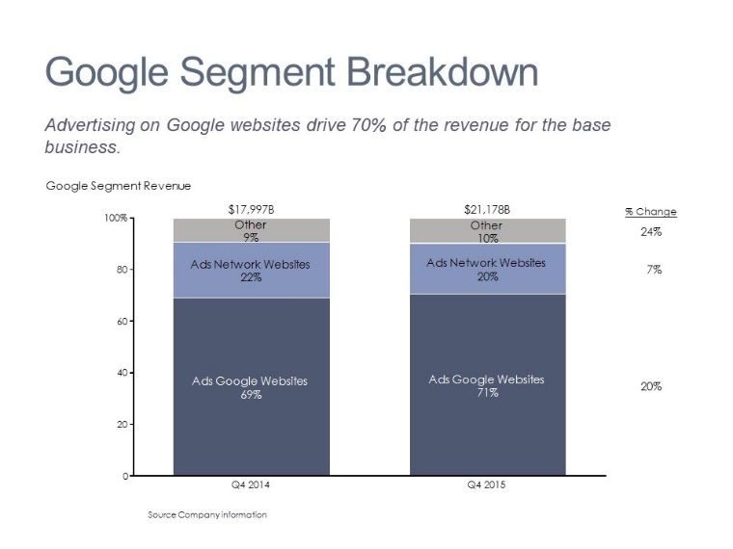
Alphabet’s Financial Results in 5 Slides

Slide 2
Market Cap Comparison
Alphabet’s market cap surpassed Apple’s on Feb 1. It grew 53% YOY while Apple’s declined 22%.
Source Company information
Notes:
Technology
Revenue
Operating income
Earnings per share
Operating margin
Time series
Data row

Slide 3
Alphabet vs. Apple Quarterly Performance
Both companies exceeded EPS expectations but revenue for Apple was slightly below consensus.
Source: Company information

Slide 4
Alphabet Segment Revenue Trend
The base business accounts for nearly all of the revenue and is growing at 16% per year.
Source Company information
Notes:
Technology
Revenue
COGS
SG&A
R&D
CAGR
Time series
Legend

Slide 5
Google Segment Breakdown
Advertising on Google websites drives 70%+ of the revenue for the base business.
Source Company information
Notes:
Technology
Revenue
COGS
SG&A
R&D
CAGR
Time series
Legend

Slide 6
Alphabet Segment Income
Profits for the base business grew 23% while Other Bets lost nearly $4B.
Source Company information
Notes:
Technology
Revenue
COGS
SG&A
R&D
CAGR
Time series
Legend

